Slide 1
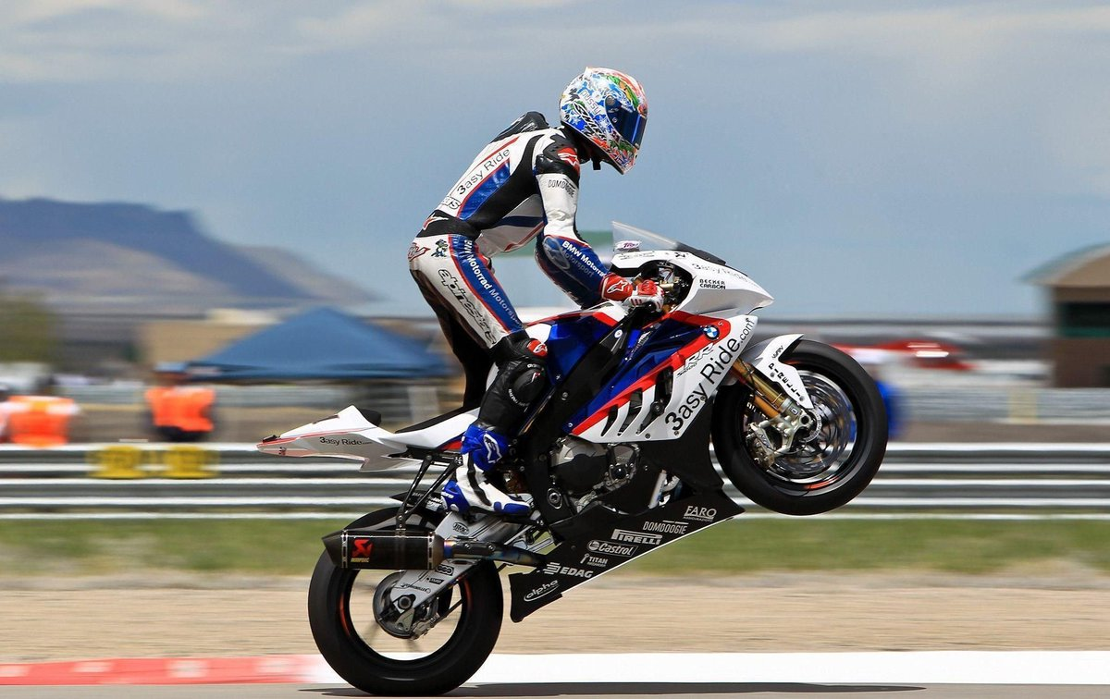


Distance vs. Time Graphs
We will interpret and draw distance-time graphs in context
Notes:
Insert cover image and use transparency settings to fade image.

Slide 2
Do not delete this slide.
This slide is designed so that you can copy the prompt box you need and insert it into your slides.
This slide is hidden and will not be included when presenting your lesson.
TRACK WITH ME
VOCABULARY
1 -
HINT
Students, remember….
CHECK FOR UNDERSTANDING
READ WITH ME
TEACHER CUE
MAKE THE CONNECTION
Students, you already know….
EXTENSION
GESTURE WITH ME

Slide 3
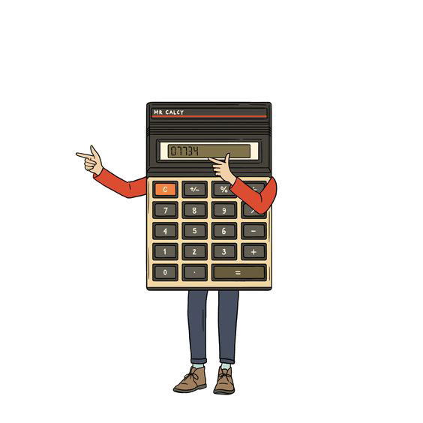
            DO NOW
Acceleration = V₂ – V₁
t
Speed = Distance
Time
Take out your calculators
A race car accelerates uniformly from 18.5 m/s to 46.1 m/s in 2.47 seconds.
Determine the acceleration of the car.
A different race car travels at 46.1 m/s along a straight stretch of race track for 8s.
What is the length of the straight?

Slide 4
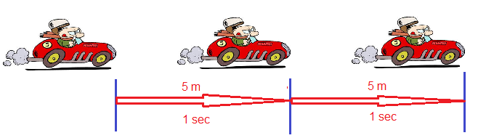
ACCELERATION
An object travelling at constant speed or velocity will travel
the same distance in the same time.

Slide 5
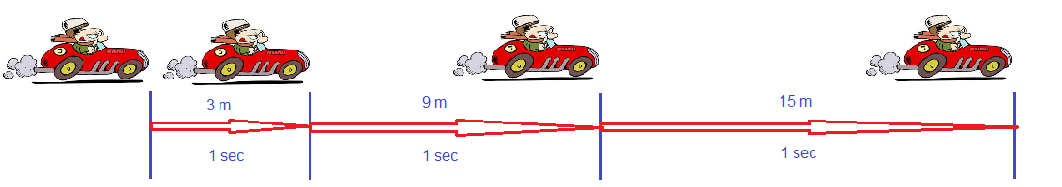
ACCELERATION
Acceleration is: the rate of change of velocity
An object which is increasing its velocity will travel further each second than it travelled in the previous second.

Slide 6
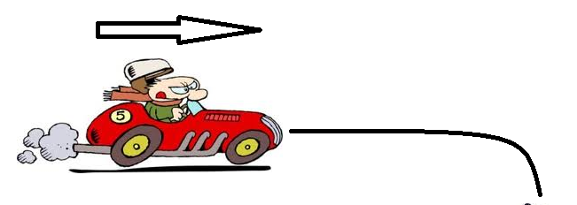
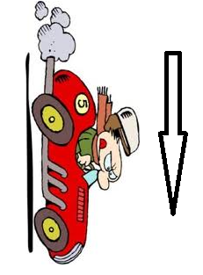
ACCELERATION
This means that if an object is accelerating it is increasing or decreasing its velocity.
An object which goes around a corner is also accelerating because the velocity has changed direction.

Slide 7
ACCELERATION
When speed is slowing, we consider the acceleration to be negative and call it deceleration.
For acceleration we use the symbol a and the SI unit is metres per second per second (m/s²).
An object travelling at constant speed has an acceleration of 0 m/s².
Notes:
27m; 23m downwards

Slide 8
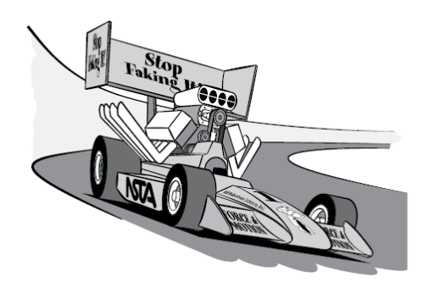


ACCELERATING OR NOT
State whether each of the following are accelerating. Explain your answers
A dog chasing its tail
An aeroplane moving at a constant speed of 500 km/hr in a straight line.
A race car rounding a corner at a constant speed of 200 km/hr
Notes:
Balance of forces

Slide 9


ACCELERATING OR NOT
Are you accelerating right now? How do you know?
You’re on a skateboard, moving very fast but at a constant speed. Are you accelerating? Explain.
Lara claims that if an object is accelerating, it must be moving. She also claims that if an object is not accelerating, it must be at rest. Do you agree with Lara? If not, what would you say to convince her she’s wrong?
Notes:
Balance of forces

Slide 10

We will interpret and draw distance-time graphs in context
TRACK WITH ME
READ WITH ME
We will be able to interpret information from distance-time graphs
We will be able to identify the scale used on distance-time graphs
We will be able to plot information onto a distance-time graph
DECLARE THE OBJECTIVE
Read the learning objective to your partner.
Notes:
Learning Objectives contain concepts (nouns, big ideas), skills (verbs, measurable behaviours) and sometimes context (restricting or targeting conditions).
●Example: Students will be able to describe the concept of density and apply it to floating and sinking.
●
Success criteria are specific measurable outcomes that if met mean that the student has met the learning objective.
Examples:
•Students will be able to compare densities of substances using mass and volume.
•Students will be able to identify whether a solid or liquid will float or sink in a liquid based on their densities.

Slide 11
A distance-time graph plots the distance an object travels against
the time it takes it to travel.
Notes:
Clipart for the car used: http://www.clker.com/clipart-red-car-top-view-8.html

Slide 12


A distance-time graph plots the distance an object travels against
the time it takes it to travel.
220
Ex1
The following distance-time graph shows a car’s journey.
200
Speed
180
220m$÷$ 10s
160
[a]
[d]
What was the car’s average speed for the whole journey?
How far did the car travel in the first 3 seconds?
140
Height
60m
120
100m
Distance along road (metres)
22m/s
100
[b]
For how long was the car stationary?
80
Speed
Width
2 seconds
60
100m$÷$ 2s
40
2s
[c]
What was the car’s greatest speed?
20
50 m/s
0
0
1
2
3
4
5
6
7
8
9
10
Time (seconds)
Notes:
Animation inspired by GeoGebra Traffic!

Slide 13


Ex2
The graph shows a cyclist’s journey, from home, to the next big city and back.
40
Solution
[a]
How long in total was the cyclist stationary during his journey?
30
Speed
20mi$÷$ 1h
1 hour 30 minutes
1.5 hours
Height
Speed
[b]
How far did the cyclist travel in total?
20mi
35mi$÷$ 2.5h
Distance from home (miles)
20
70 miles
Height
[c]
What was the cyclist’s speed on the way home?
35mi
Width
10
14 mph
1h
Width
[d]
What was the cyclist’s greatest speed?
2.5h
20 mph
0
0
1
2
3
4
5
6
7
Time (hours)

Slide 14
Q1
A train travels from Goldenrod City to Saffron City. The train leaves at 09:15 and stops at Route 32 along the way. The distance-time graph below shows the train’s journey.
Solution
[a]
What is the distance between Goldenrod City and Route 32?
200
110 miles
[b]
How long did the train stay at Route 32?
150
30 minutes
[c]
What speed did the train travel between Route 32 and Saffron City?
100
Distance travelled (miles)
120 mph
[d]
How far did the train travel in total?
50
200 miles
[e]
What was the train’s average speed for the entire journey?
0
80 mph
09:00
10:00
11:00
12:00
Time

Slide 15
Q2
Callum cycles from his home to the supermarket and back.
The following distance-time graph describes his journey.
Solution
[a]
How long did it take Callum to get to the supermarket?
5
30 minutes
4
[b]
How long did Callum spend in the supermarket?
45 minutes
3
[c]
What was Callum’s speed on his journey home?
Distance from home (miles)
10.8 mph
2
[d]
What was the total distance Callum travelled?
1
9 miles
[e]
How long was Callum away from his home for?
0
11:30
12:00
12:30
13:00
13:30
1 hour 40 minutes
Time

Slide 16
Q3
Paul travels to his parents’ house and then returns home.
The distance-time graph shows information about Paul’s journey.
Solution
[a]
What time did Paul start his journey?
8
12:40
Paul stops at a shop along the way.
6
[b]
For how long was Paul at the shop?
10 minutes
4
[c]
How far do Paul’s parents live from the shop?
Distance from home (miles)
3 miles
[d]
Work out the total distance Paul travelled.
2
14 miles
[e]
Work out Paul’s average speed on his journey home.
21 mph
0
12:30
13:30
14:30
Time

Slide 17

Q4
A remote control car travels in a straight line.
The following graph describes its distance travelled over time.
Solution
[a]
What is the total distance travelled by the car?
20
20 metres
[b]
How far had the car travelled after 8 seconds?
16
10 metres
0.5 m/s
B
[c]
What was the car’s overall average speed?
12
C
3.5 m/s
1.4 m/s (1dp)
Distance travelled (metres)
8
[d]
For how long was the car travelling a speed of 3m/s?
A
A
1 second
4
[e]
What is the difference between the car’s fastest and slowest speeds?
0
B
C
Difference $=$ 3 m/s
0
5
10
15
Time (seconds)

Slide 18
Q5
Five distance-time graphs are shown.
Each box below describes one graph.
Write the letter of the correct graph next to its description.
Distance
from
home
Graph C
Solution
Distance
from
home
Graph A
1 | Khalid walked home slowly from his friend’s house.
2 | Natalie walked steadily to the park.
Time
E
C
Distance
from
home
Graph E
Time
3 | Sophie walked to school, stopped to look at her watch, realised she was late and then started running.
5 | Michael went out with his friends, realised he had left his wallet at home. He ran home to get it and then ran again to catch up with his friends.
Graph B
D
B
Distance
from
home
Graph D
Time
Distance
from
home
4 | David walked to his local gym. Stayed there for a workout and then ran home.
Time
A
Time
Notes:
Question inspired by CorbettMaths!

Slide 19



Ex3
The graph shows part of Matthew’s journey to the gym and back.
12
Solution
[a]
Find Matthew’s speed on his way to the gym.
10
9.6 km/h
8
Matthew stayed at the gym for 75 minutes before travelling home at 16 km/h.
Height
Distance from home (km)
6
12km
[b]
Complete the distance-time graph.
4
Speed
12km $÷$ 1.25h
Speed | Distance | Time
16 km/h | 12 km | 45mins
2
Width
1h15m
0
Time
0
1
2
3
12km $÷$ 16km/h
$=$ 0.75 hours
Time (hours)

Slide 20





Ex4
Lucy leaves home at 08:00.
She walks at a speed of 4mph for 15 minutes before immediately running at 8mph for a further 45 minutes.
She then stops for half an hour.
Lucy then sets off home and arrives at 10:45.
Distance
8
Distance
4mph $×$ 0.25h
8mph $×$ 0.75h
$=$ 6mi
$=$ 1mi
Solution
6
Speed
7km $÷$ 1.25h
Distance from home (miles)
4
Height
[a]
Draw the distance-time graph for Lucy’s journey.
7km
2
[b]
What was Lucy’s average speed on her way home?
Width
5.6mph
1h15m
0
08:00
09:00
10:00
11:00
Time (hours)

Slide 21
Q6
Steve leaves home at 11:15am.
He drives at an average speed of 60mph for 45 minutes. He then stops for 45 minutes.
Steve then sets off home and arrives at 14:00.
60
Solution
[a]
Draw the distance-time graph for Steve’s journey.
40
Distance from home (miles)
[b]
What was Steve’s average speed on his way home?
20
36mph
[c]
How far did Steve travel in total?
90 miles
0
11:00
12:00
13:00
14:00
Time (hours)

Slide 22
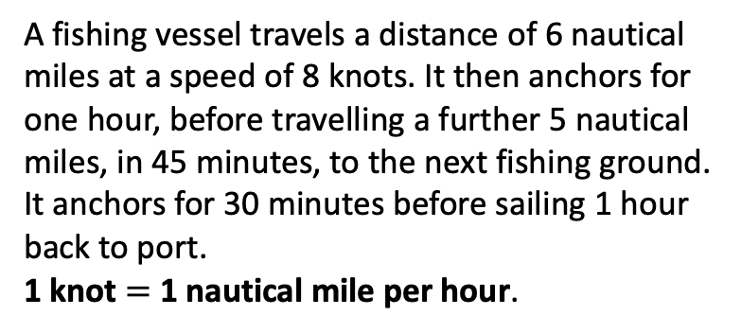
Q7
A fishing vessel travels a distance of 6 nautical miles at a speed of 8 knots. It then anchors for one hour, before travelling a further 5 nautical miles, in 45 minutes, to the next fishing ground. It anchors for 30 minutes before sailing 1 hour back to port.
1 knot $=$ 1 nautical mile per hour.
12
Solution
10
8
Distance from shore (nautical miles)
6
[a]
Draw the distance-time graph for the fishing vessel.
4
2
[b]
What was the vessel’s average speed for the entire journey?
0
5.5 knots
0
1
2
3
4
Time (hours)

Slide 23
Q8
Alan leaves home at 10:15.
He drives at an average speed of 40mph for 2½ hours. He then stops for 45 minutes.
Alan then sets off home, travelling at 30mph for 1 hour, before speeding up to 56mph for the rest of the journey.
120
Solution
100
80
Distance from home (miles)
60
[a]
Draw the distance-time graph for Alan’s journey.
40
[b]
What time did Alan arrive home?
20
15:45
0
10:00
12:00
14:00
16:00
Time (hours)

